Slide 1
Pokemon card game information around the globe
By Shajan Reynold

Slide 2
Statement of project
Count of Pokemon types
Special attack and defense combos of type of pokemon
Origin of pokemon types
Generation types of pokemon
Count of Pokemon on each year

Slide 3
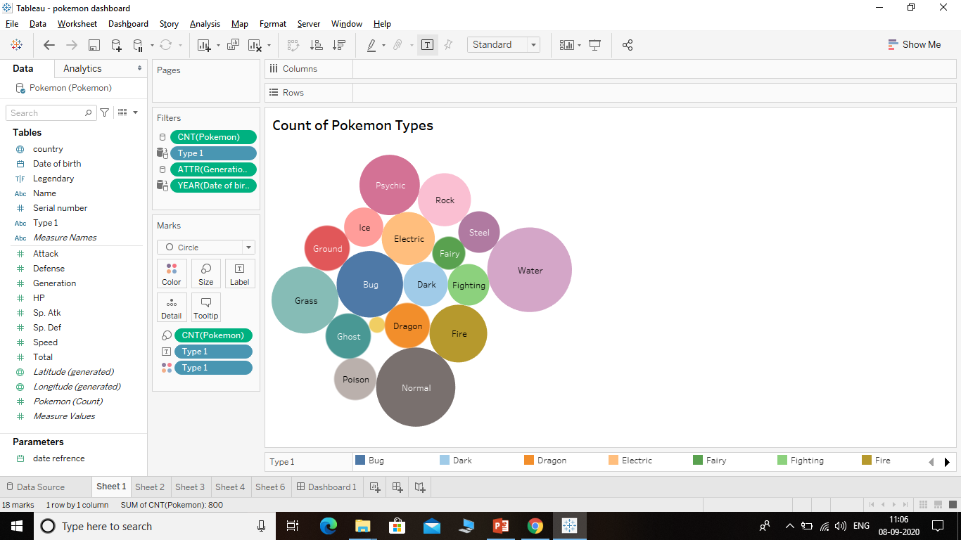
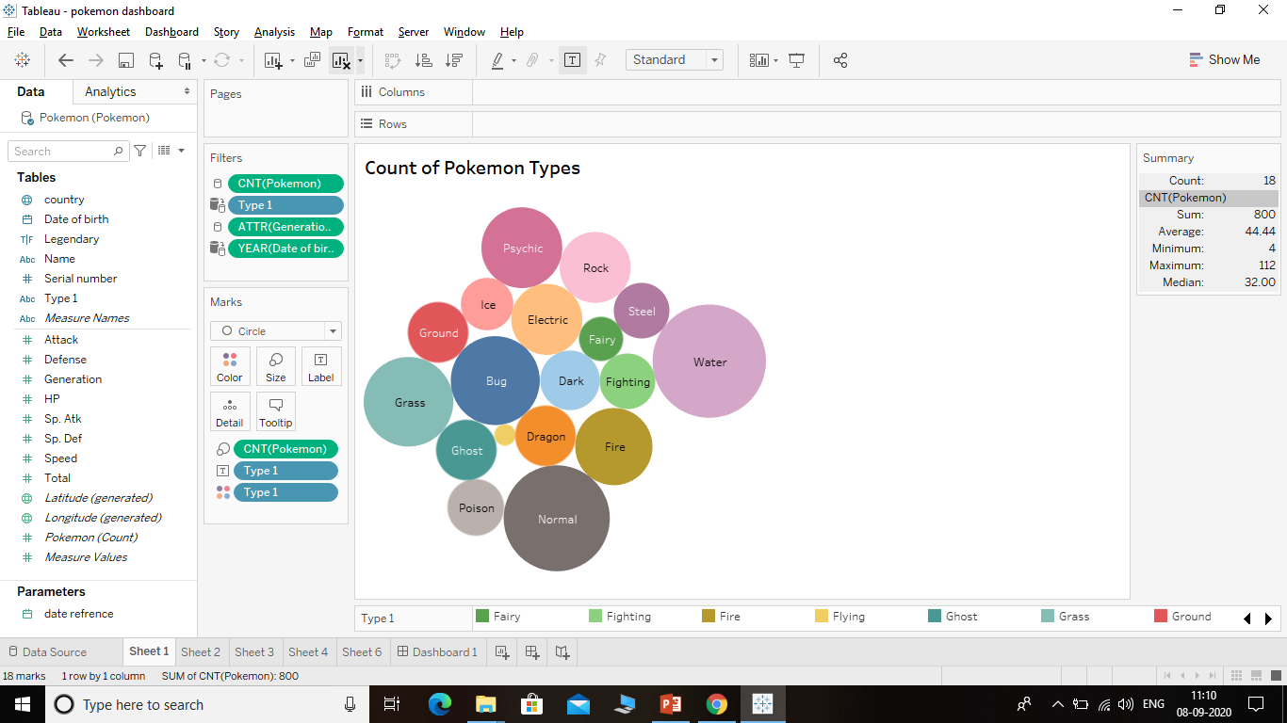
Count of Pokemon types
according to the Bubble chart the count of type of pokemon ranges from 4-112
The minimum count of pokemons are flying type pokemon which is 4 of them all over the world
The maximum number of pokemon type are water type pokemon which are 112 in count all over the world
Altogether there are 800 pokemon average count of them across the world is 45

Slide 4
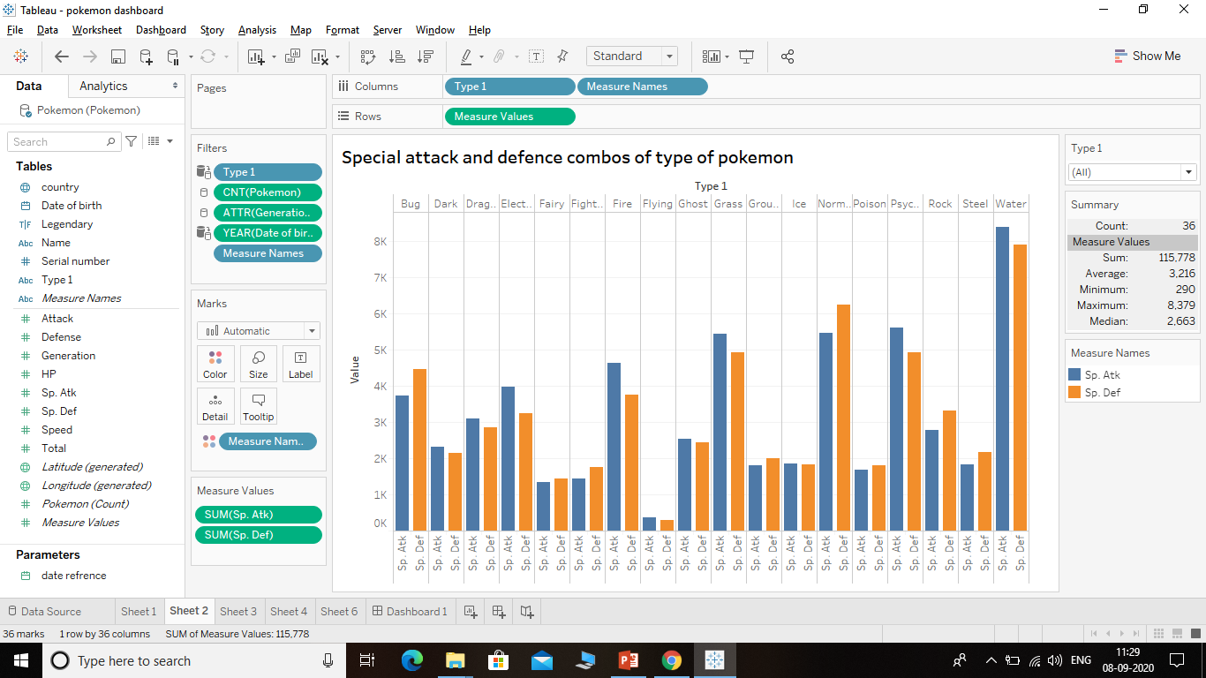
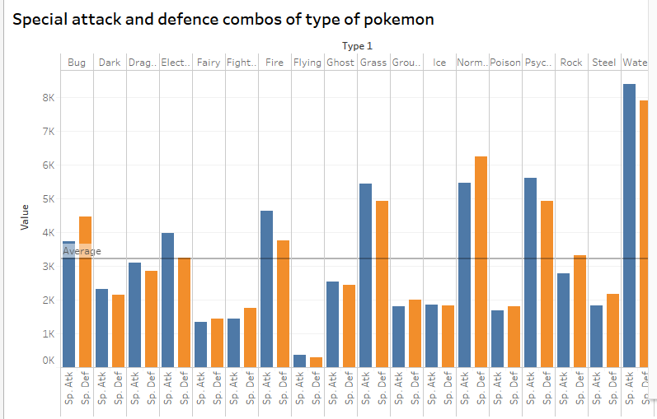
Special attack and defense combos of type of pokemon
In the side by side bar chart the pokemon special attacks and defense combos are depicted according to their types
Maximum special attacks and defense are for water type pokemons i.e.; 8379 points and 7898 points
Minimum special attacks and defense are for flying type pokemon i.e. ; 377 points and 290 points
In combat water type has more advantage over flying type pokemon

Slide 5
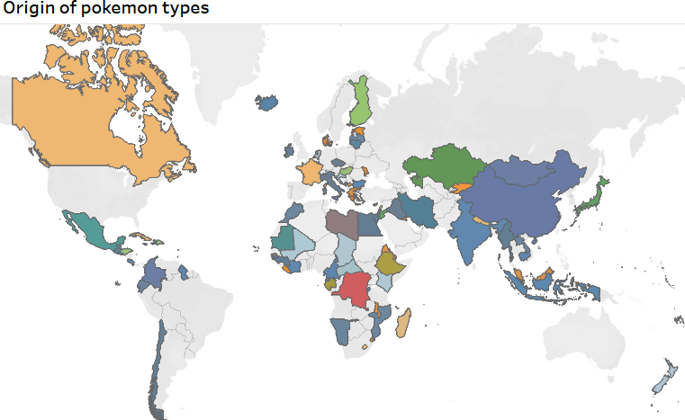
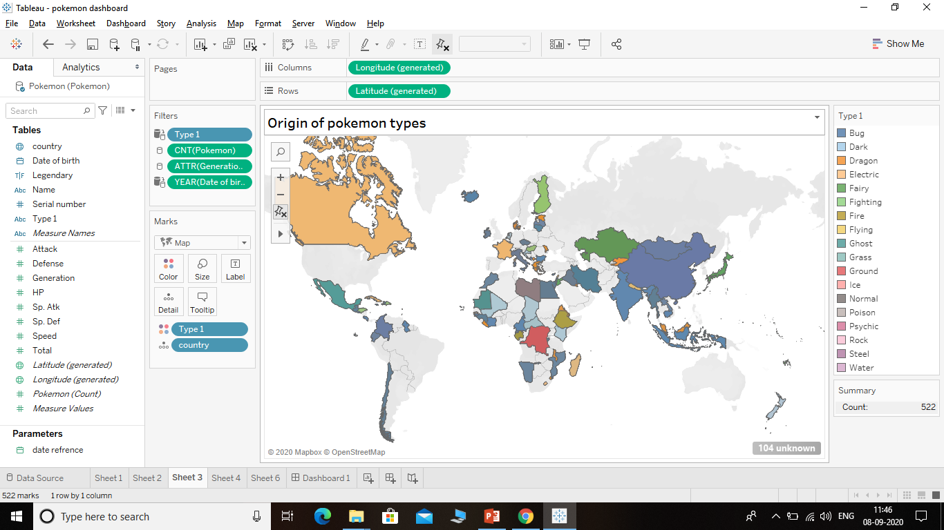
Origin of pokemon types
Origin of pokemon tells us about the pokemon origins i.e.; their birth place
Among 800 pokemon there are 522 pokemons are located and 278 pokemon origins are unknown

Slide 6
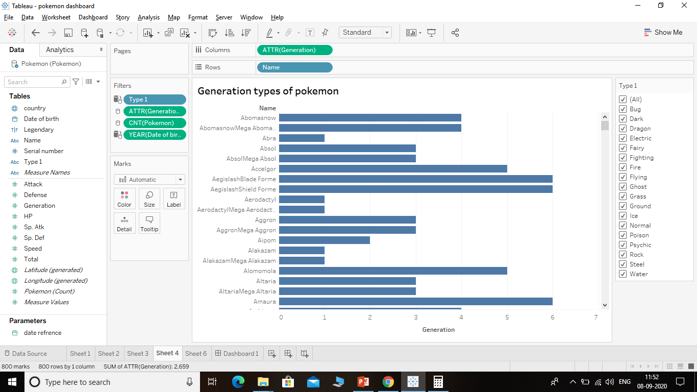
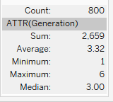
Generation types of pokemon
In this chart pokemon types and each pokemon are classified into what all generations are they from
Maximum number of pokemon are from 6th generation
Minimum number of pokemon are from 1st generation

Slide 7
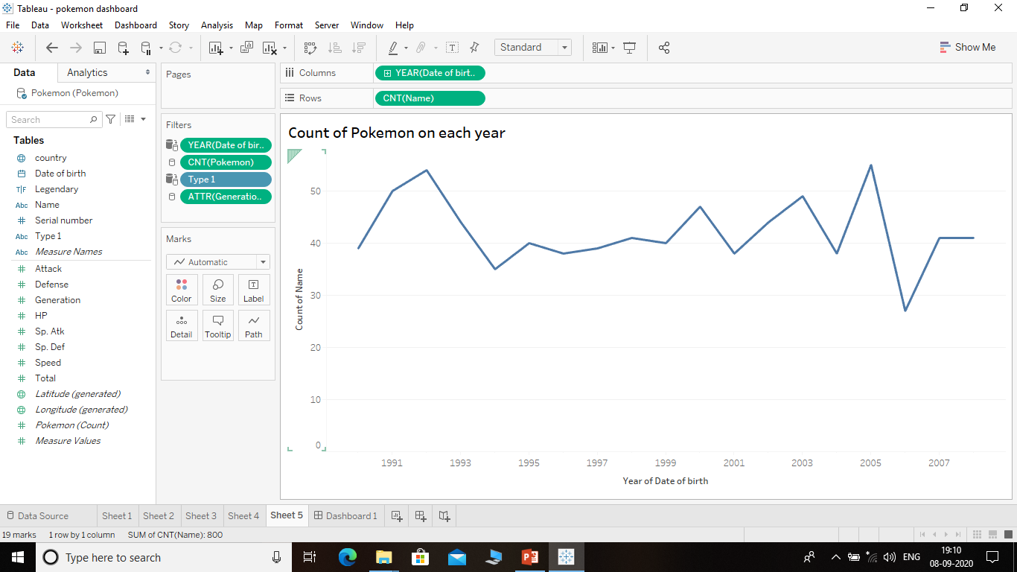
Count of Pokemon on each year
In this line chart we can see the count of pokemon born each year from 1990 – 2008
The maximum number of pokemon born was in the year 2006 i.e.; 55
The minimum number of pokemon born was in the year 2005 i.e.; 27

Slide 8
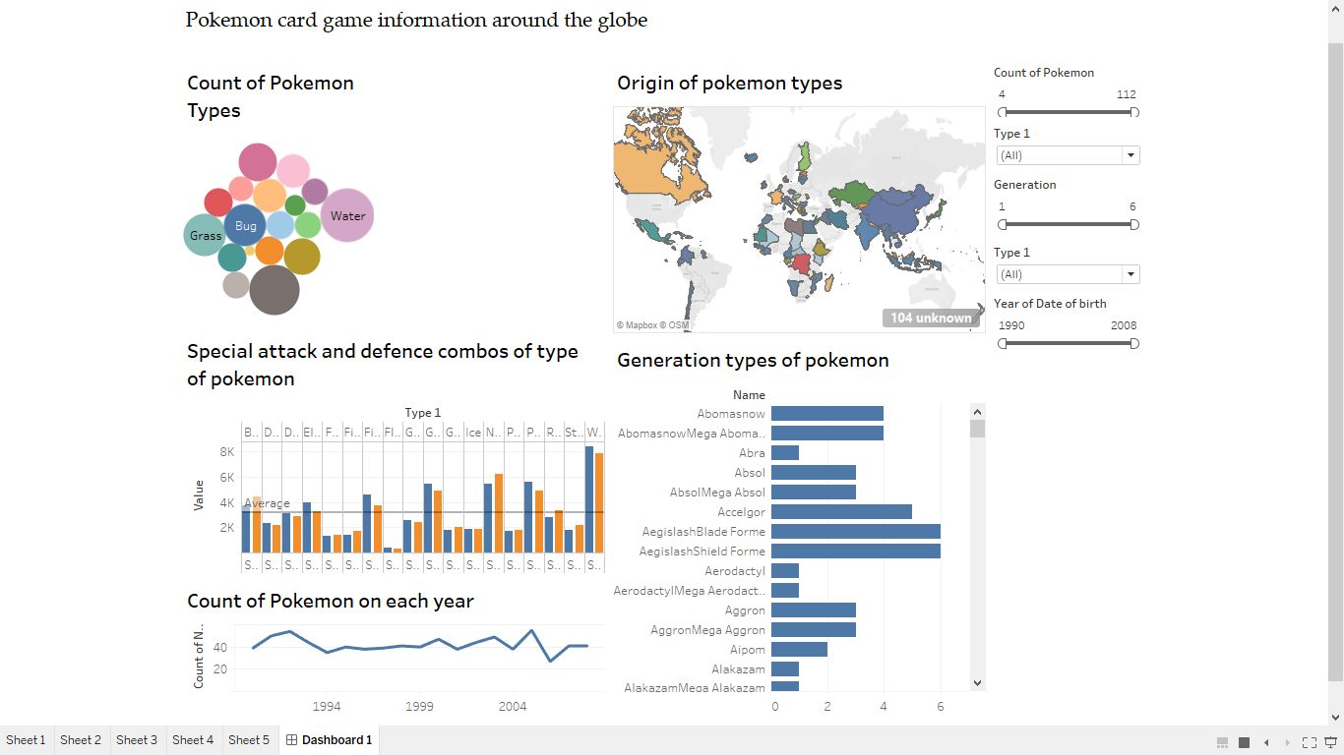
Dashboard

Slide 9
Conclusion
water type pokemon are more in number compared to other types of pokemon
In combat water type pokemon has more advantage due their increased amount of special attacks and defense while comparing to other types of pokemon the
One with highest disadvantage are flying type pokemon due to lower attacking point they are even below the average point
Out of 800 variety of pokemon only 522 are found to be located other 278 pokemon location are still unknown
Maximum count of pokemon are in 6th generation and minimum number are in 1st generation
While looking at year were pokemon generated we can see that there are increased number of pokemon generated in the year 2006 and decreased amount in the year 2005

Slide 10
Sources and links
Link to the pokemon dataset : https://drive.google.com/file/d/1WHS_mKL5vjn0qpsmHNiJSF4O_lQDnom-/view?usp=sharing
Link to my dashboard : https://drive.google.com/file/d/1EAw6l82FNIOU7WL83bdH_yRVQO5PhrjF/view?usp=sharing
Link to the source of dataset :
https://www.kaggle.com/abcsds/pokemon

